Slide 1
June 2022
INVESTOR PRESENTATION

Slide 2
FORWARD-LOOKING STATEMENTS
In connection with the “safe harbor” provisions of the Private Securities Litigation Reform Act of 1995, The Gorman-Rupp Company provides the following cautionary statement: This presentation contains various forward-looking statements based on assumptions concerning The Gorman-Rupp Company’s operations, future results and prospects. These forward-looking statements are based on current expectations about important economic, political, and technological factors, among others, and are subject to risks and uncertainties, which could cause the actual results or events to differ materially from those set forth in or implied by the forward-looking statements and related assumptions. These include statements regarding estimates of future earnings and cash flows. Other uncertainties include, but are not limited to, general economic conditions, supply chain conditions and any related impact on costs and availability of materials, integration of Fill-Rite in a timely and cost effective manner, retention of supplier and customer relationships and key employees, and the ability to achieve synergies and cost savings in the amounts and within the time frames currently anticipated. Other risks and uncertainties that may materially affect Gorman-Rupp are described from time to time in its reports filed with the Securities and Exchange Commission, including Forms 10-K, 10-Q, and 8-K. Except to the extent required by law, Gorman-Rupp does not undertake and specifically declines any obligation to review or update any forward-looking statements or to publicly announce the results of any revisions to any of such statements to reflect future events or developments or otherwise.

Slide 3
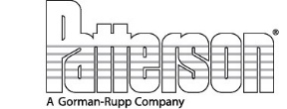
Company Overview
Leading designer and manufacturer of pumps and pump systems
Product diversity with significant presence in Fire Suppression, Municipal , Construction, Agriculture, Industrial, Petroleum and OEM markets
Reputation for quality products and outstanding service
Recognizable family of brands through product development and acquisitions
Strong network of domestic and international distributors
International sales to approximately 135 countries representing 31% of total sales
History of returning capital to shareholders through dividends
Acquisition of Fill-Rite as of May 31, 2022

Slide 4
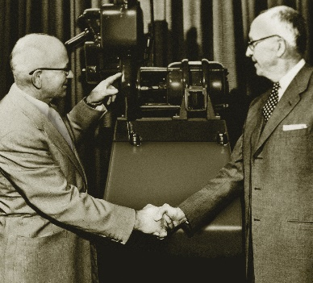
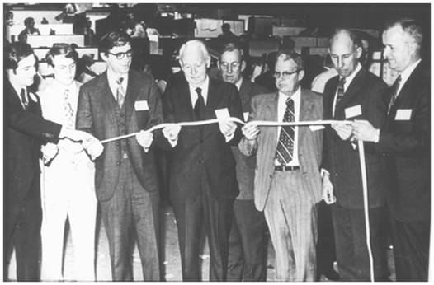
Company History
1933 - Company founded with $1,500 initial – and only – capital
investment
1956 - First international expansion – established Canadian manufacturing
facility
1968 - Publicly listed (American Stock Exchange → NYSE MKT → NYSE in 2017)
1988 - Acquired Patterson Pump Company, manufacturer of large volume pumps for sewage, flood control and fire suppression
1998 - Patterson Pump Ireland established for manufacture and sale of fire pumps in Europe
2010 - Acquired National Pump Company, submersible vertical turbine manufacturer serving the agricultural irrigation, municipal and petroleum markets
2002 - 2016 - Multiple smaller international and domestic acquisitions
2022 - Total of 73 years of cash dividends and 49 consecutive years of
increases
2022 - Acquisition of Fill-Rite, leading provider of fixed and
portable fuel transfer pumps, chemical transfer pumps, meters, and
accessories

Slide 5
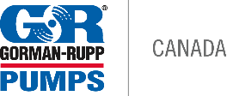
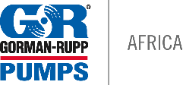
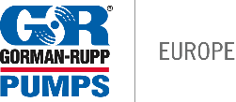
GLOBAL OPERATIONS
GORMAN-RUPP PUMPS GROUP
NATIONAL PUMPS GROUP
Gorman-Rupp Pumps USA
Mansfield, OH
USA
www.grpumps.com
National Pump Company
Glendale, AZ; Fresno, CA; Zolfo Springs, FL; Olive Branch, MS; Lubbock, TX; Houston, TX
USA
www.nationalpumpcompany.com
Gorman-Rupp of Canada Limited
St. Thomas, Ontario
Canada
www.grpumps.ca
Gorman-Rupp Africa Proprietary Limited
Johannesburg, Cape Town & Durban
South Africa
www.gormanrupp.co.za
CUSTOM PUMPS GROUP
Gorman-Rupp Europe B.V.
Waardenburg, The Netherlands
Namur, Belgium
www.grpumps.eu
Gorman-Rupp Industries Division
Bellville, OH
USA
www.gripumps.com
PATTERSON PUMPS GROUP
AMT Pump Company
Royersford, PA
USA
www.amtpump.com
Patterson Pump Company
Toccoa, GA
USA
www.pattersonpumps.com
FILL-RITE COMPANY
Patterson Pump Ireland Limited
Mullingar
Ireland
www.ie.pattersonpumps.com
Fill-Rite Company
Fort Wayne, IN; Lenexa, KS
USA
www.fillrite.com

Slide 6
Industry Overview
Pumps touch our daily lives – drinking water, wastewater, sewage, irrigation, appliances, transportation, fuel, industrial, chemical, fire suppression, construction, HVAC
Many specialized pumps – due to many specialized applications
Very fragmented and niche oriented
Increasing worldwide demand for water and other fluid-handling equipment
Pumps are approximately 11% of water infrastructure needs
Many competitors are divisions of larger companies
General pricing stability due to extent of value-added products and mature competition

Slide 7
MARKET DIVERSITY – BY DESIGN
Water & Water-Related (58%)
Fire Suppression (24% - 27%)
Municipal Water / Wastewater & Flood Control (15% - 18%)
Construction & Dewatering (8% - 10%)
Agriculture & Irrigation Supply (4% - 5%)
Non-Water (29%)
Industrial/Chemicals & HVAC Supply (16% - 18%)
Refined Petroleum (4% - 5%)
OEM (8% - 10%)
Repair Parts (12% - 13%)
Excludes Fill-Rite

Slide 8
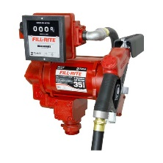
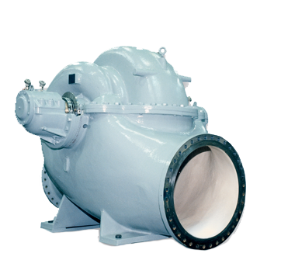
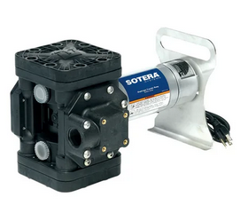
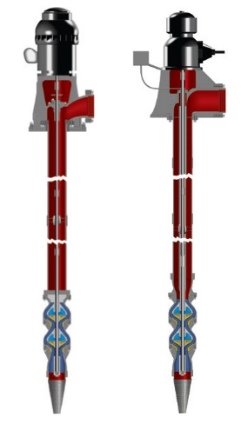
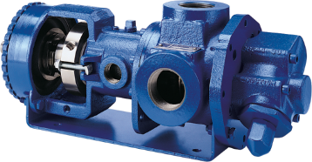
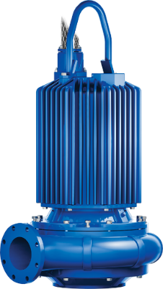
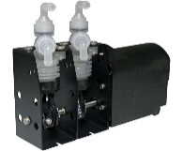
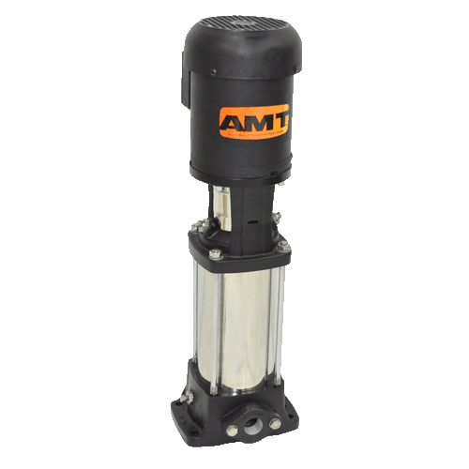
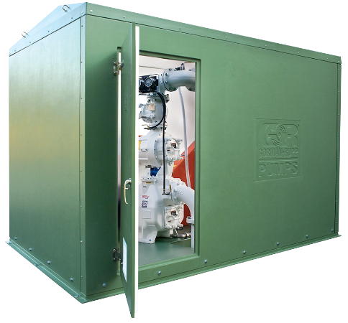
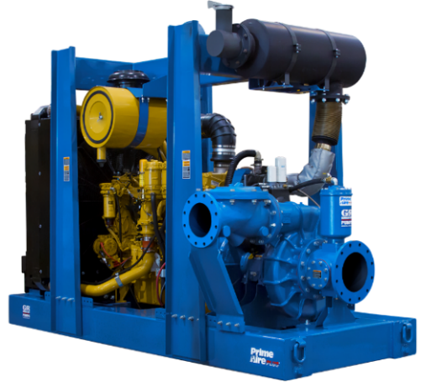
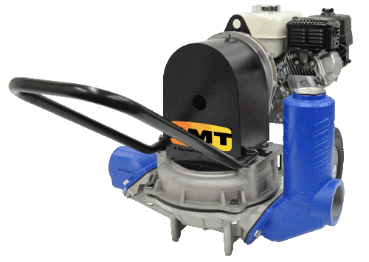
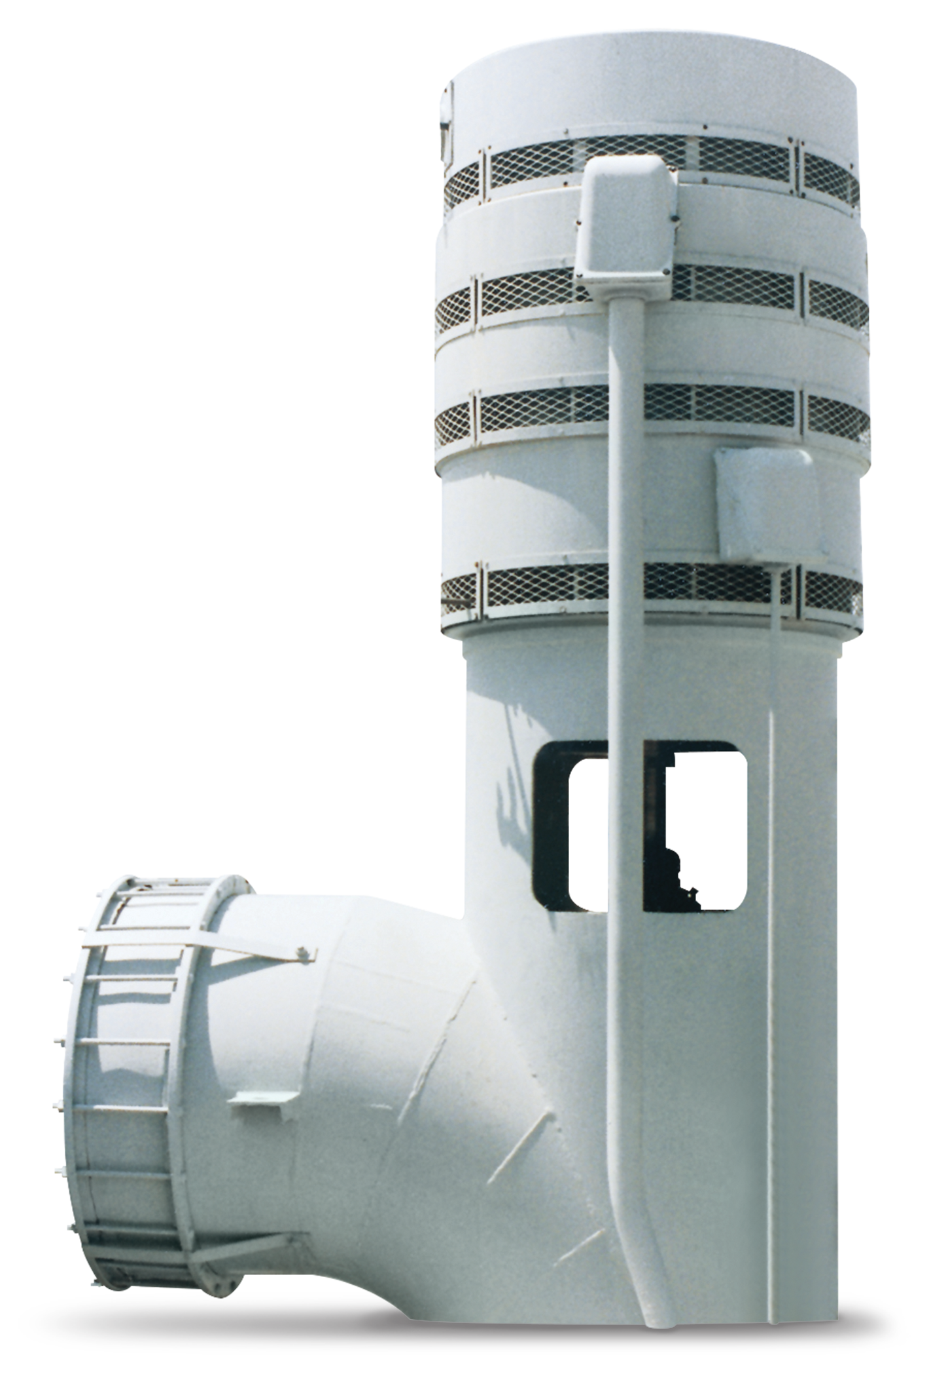
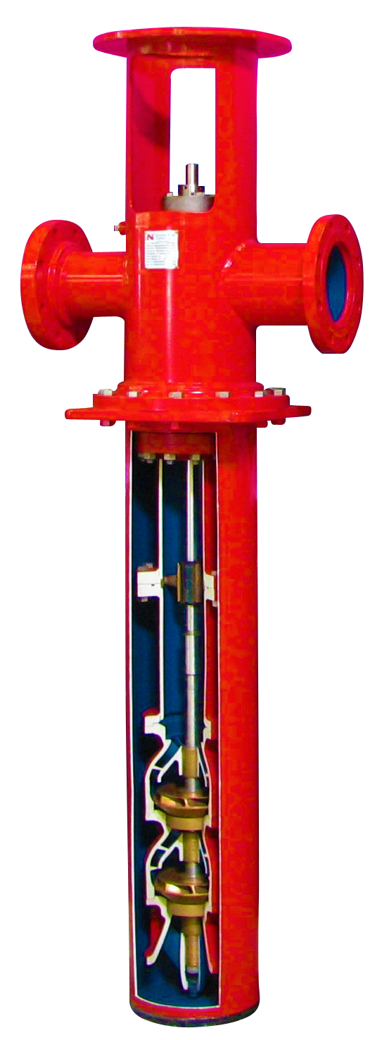
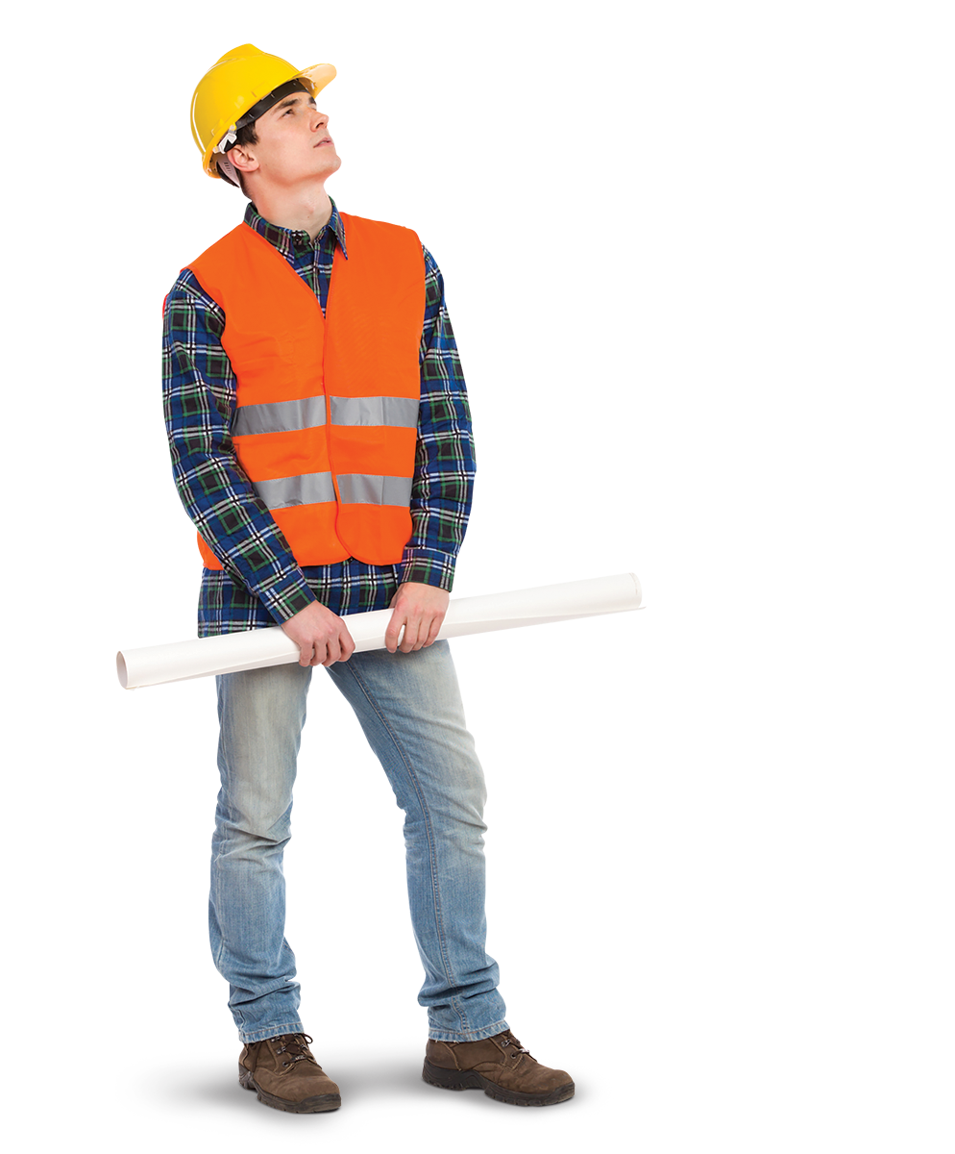
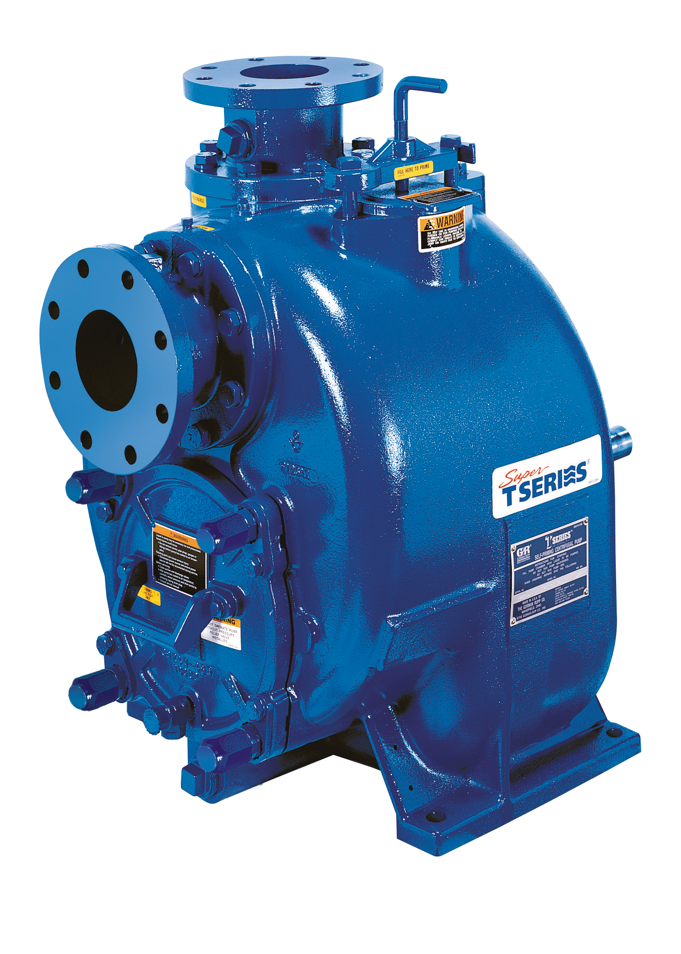
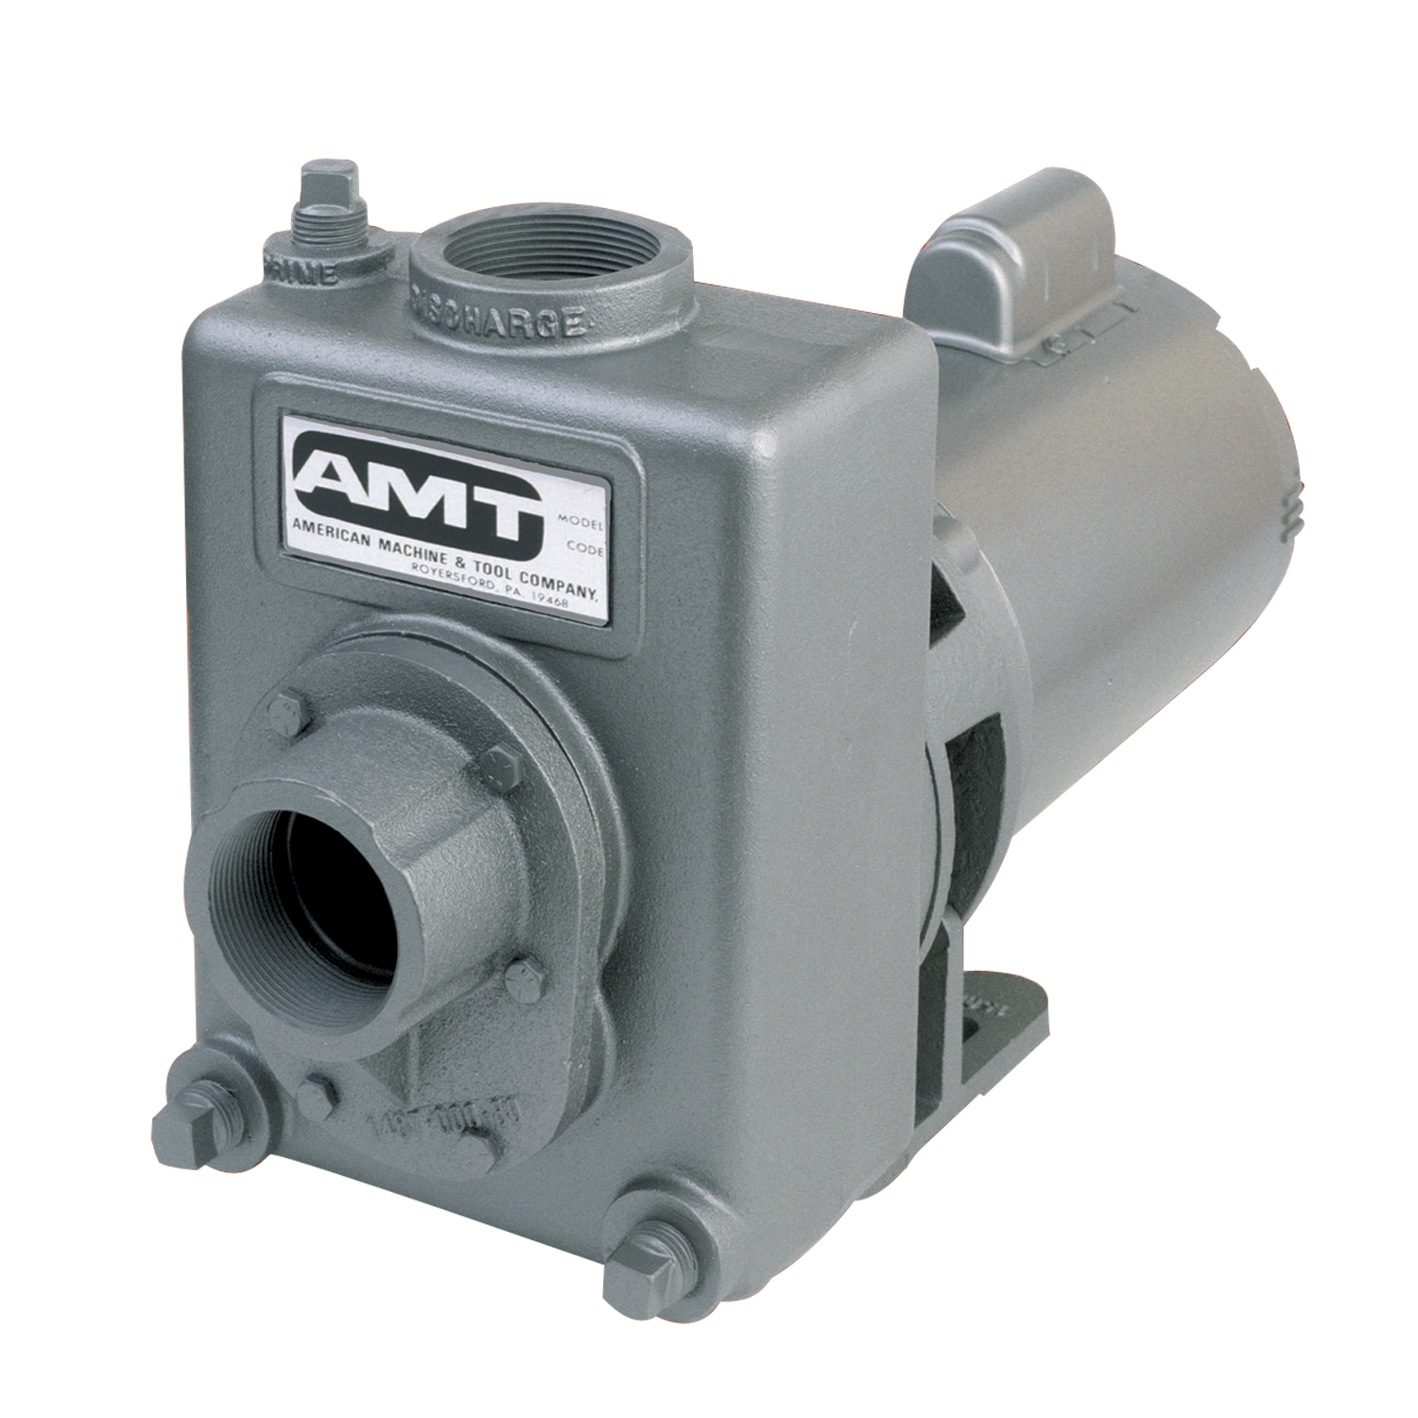
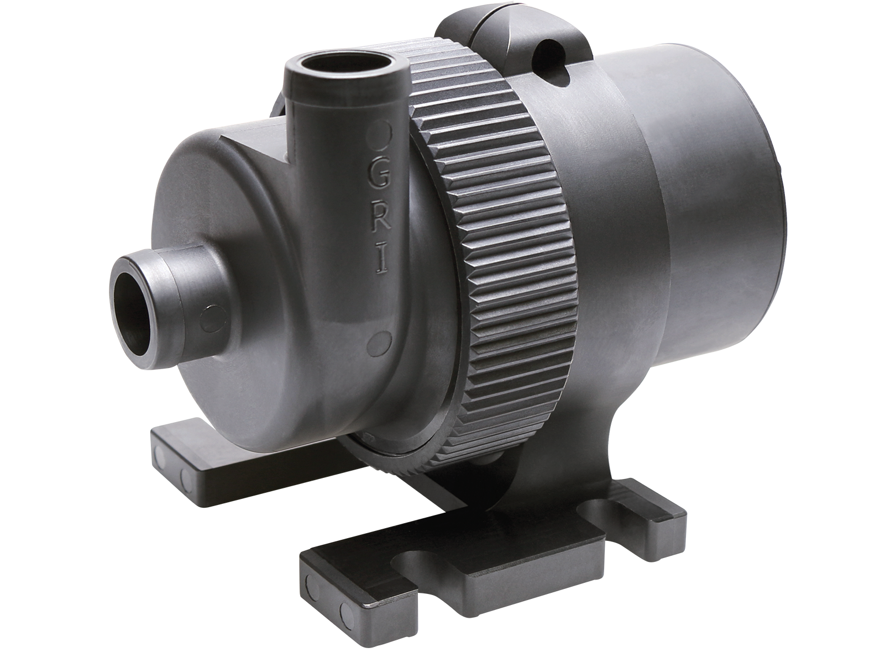
PRODUCT DIVERSITY

Slide 9
WATER MARKETS

Slide 10
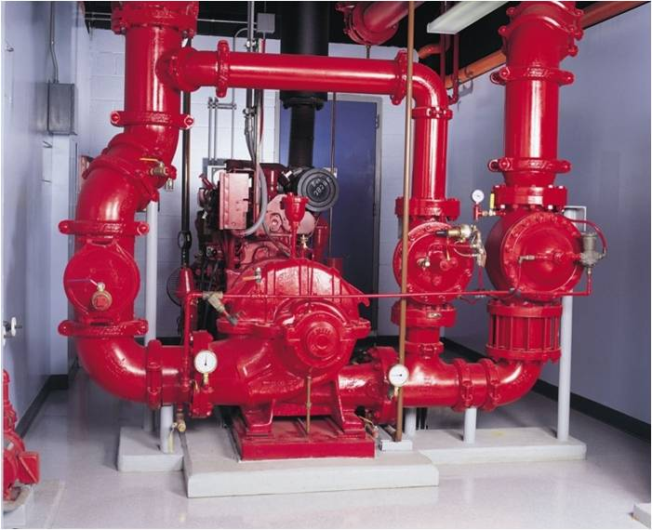
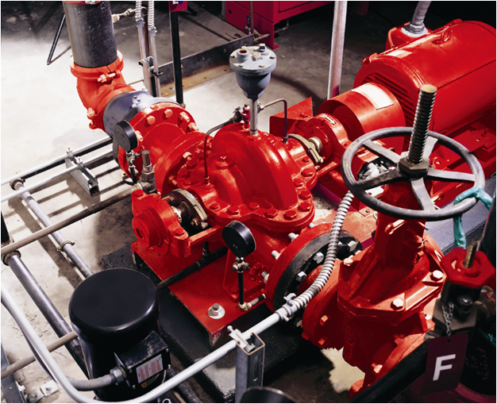
FIRE SUPPRESSION (24% - 27%)
Booster pumps for sprinkler systems in large commercial structures
Fire pumps are FM Global approved and an industry standard
Manufacturing facility in Ireland for increased capacity
Domestic and international market leader
DRIVERS: Commercial and industrial construction

Slide 11
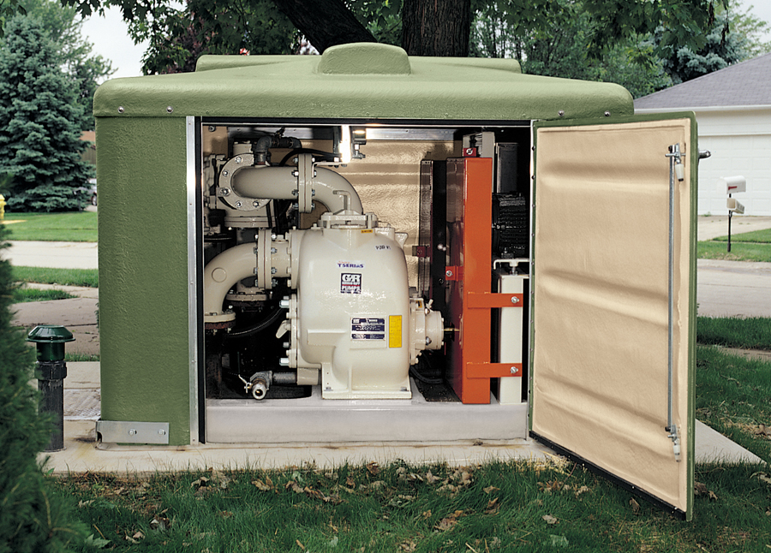
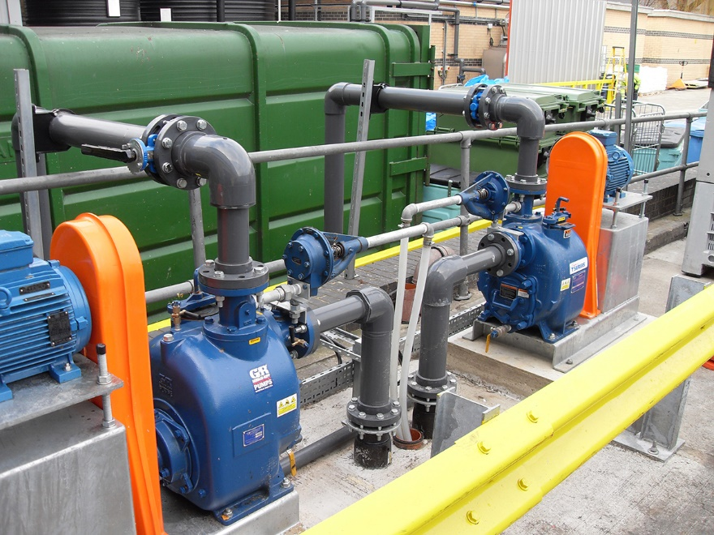
MUNICIPAL WATER & WASTEWATER (15% - 18%)
Pumps and wastewater stations
Pre-engineered turn-key systems
Custom design capabilities, above and below ground installation
Booster pumps and deep-well line shaft pumps provide clean drinking water
Municipal water and sewer funding is typically service fee based, not tax based
50th anniversary of first sewage pumping station in 2019
DRIVERS: Commercial and residential construction; infrastructure build and re-build

Slide 12
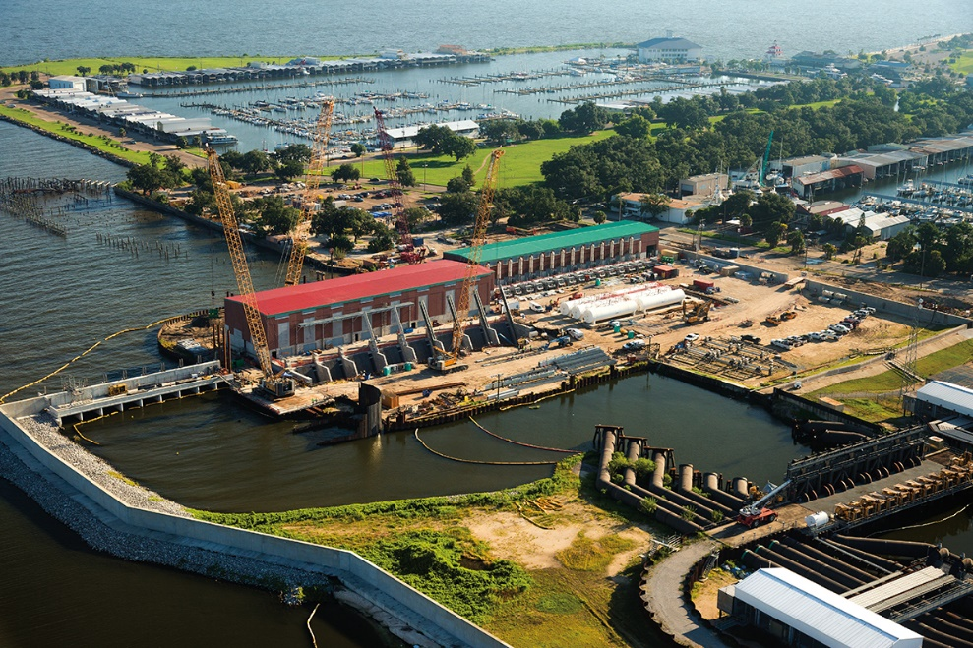
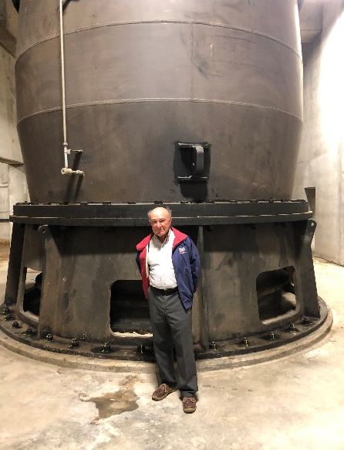
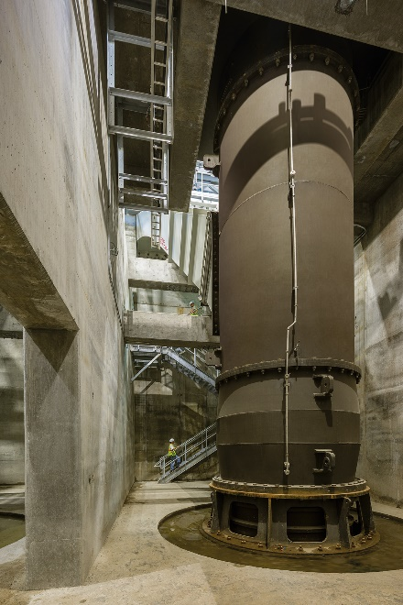
STORM WATER & FLOOD CONTROL
Flood control pumps capable of pumping up to one million gallons per minute
Permanent Canals Closure and Pumps Project completed in New Orleans in 2017
Acquisition of Morrison Pump Company in 2016
DRIVERS: Infrastructure build and re-build, natural disasters

Slide 13
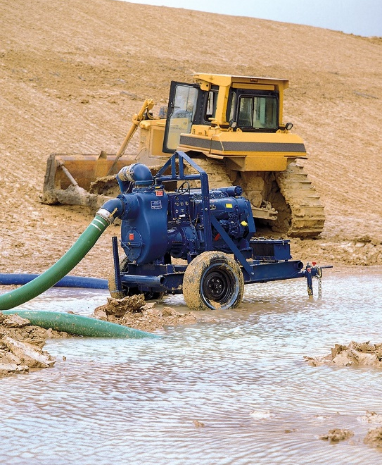
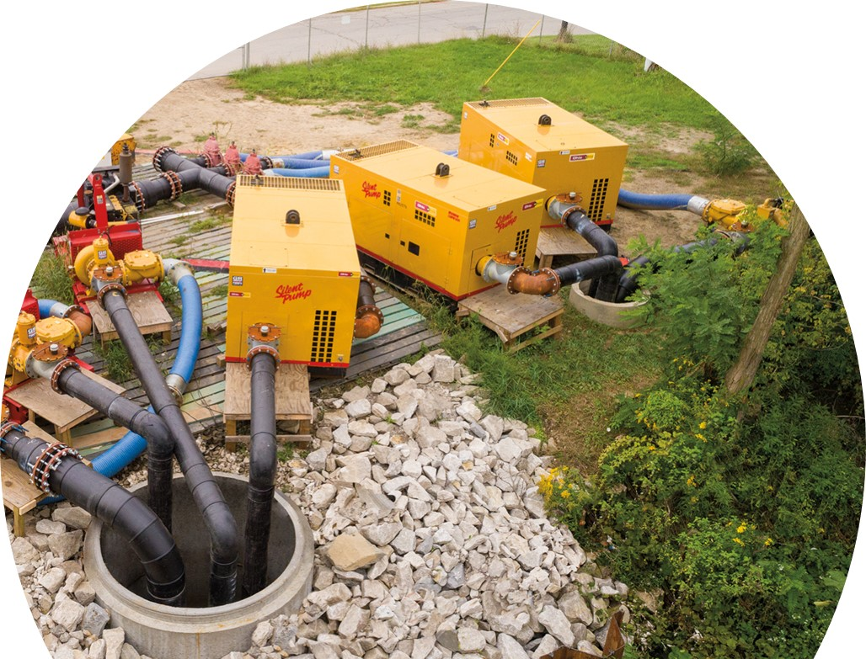
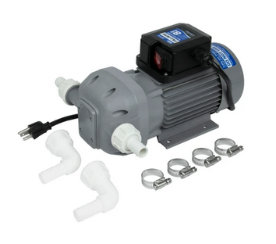
CONSTRUCTION & DEWATERING (8% - 10%)
Self-priming centrifugal pumps for dewatering foundations, quarries, ditches and streams
Diaphragm pumps to remove mud and sand laden water at construction sites
Rotory vane fuel transfer pumps, meters, and accessories for contractors
Support of fracking industry
Industry leader and innovator
DRIVERS: Infrastructure and other exterior construction; commercial rental activity and inventory turnover; mining

Slide 14
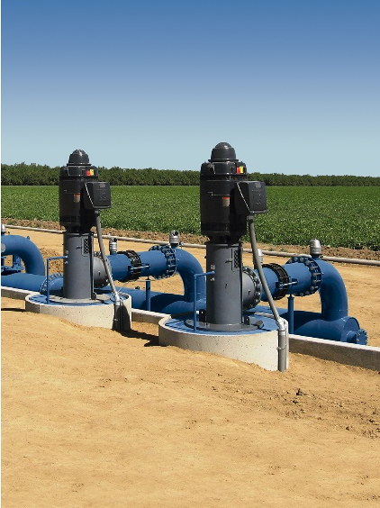
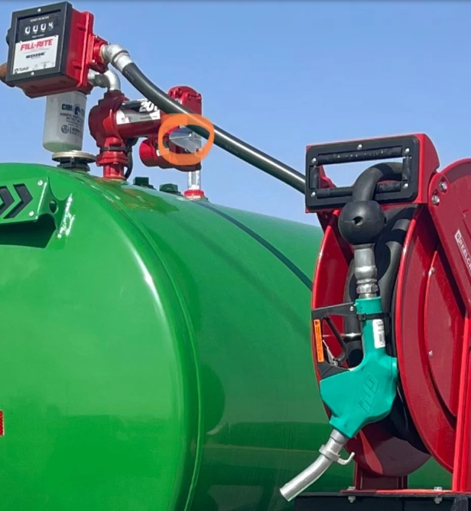
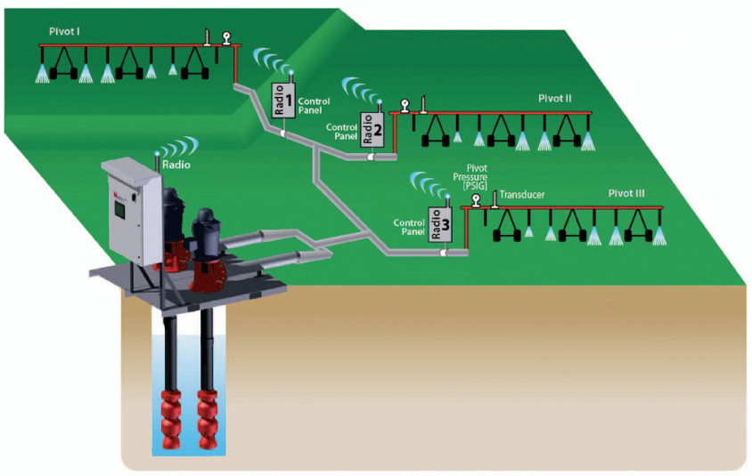
AGRICULTURE & irrigation (4% - 5%)
Irrigation pumps supplied to sprinkler installation companies
Strategically located branch locations across the U.S.
Pumps for animal waste, pit agitation, fuel transfer and liquid fertilizer
DRIVERS: Grower cash flows from farm commodity prices; bank financing requirements; weather conditions

Slide 15
NON-WATER MARKETS

Slide 16
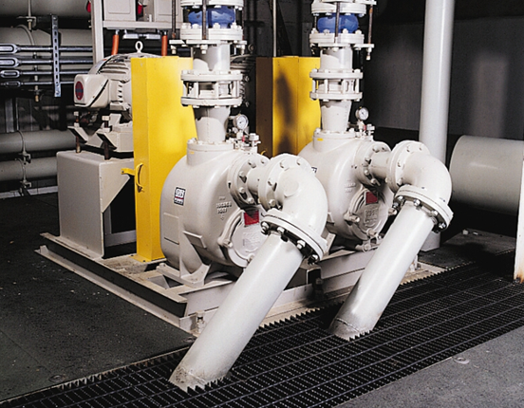
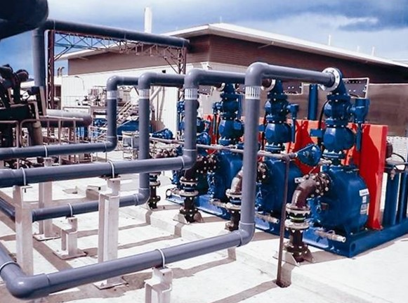
INDUSTRIAL / CHEMICALS & HVAC SUPPLY (16% - 18%)
Dependable pumps for manufacturing applications
Pumps for moving heavy sludges, slurries and other viscous materials
HVAC pump market share expanding
DRIVERS: Industrial construction, and expansion and remodeling

Slide 17
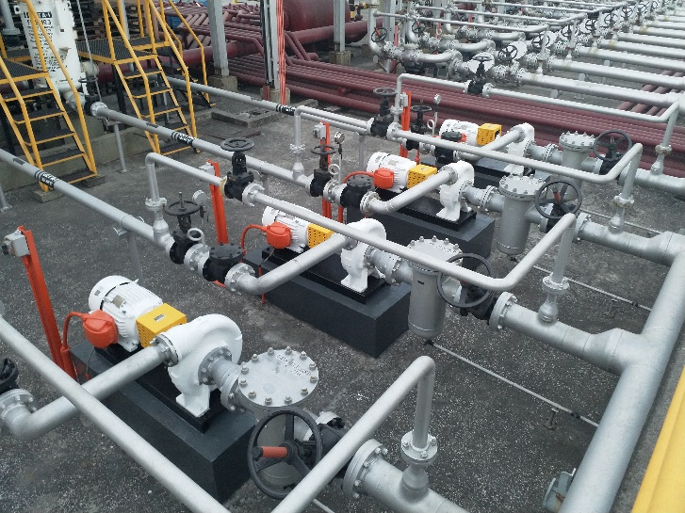
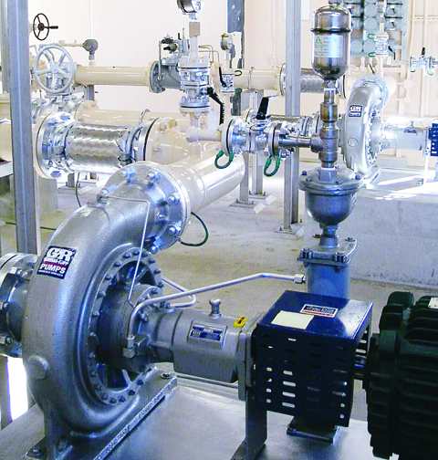
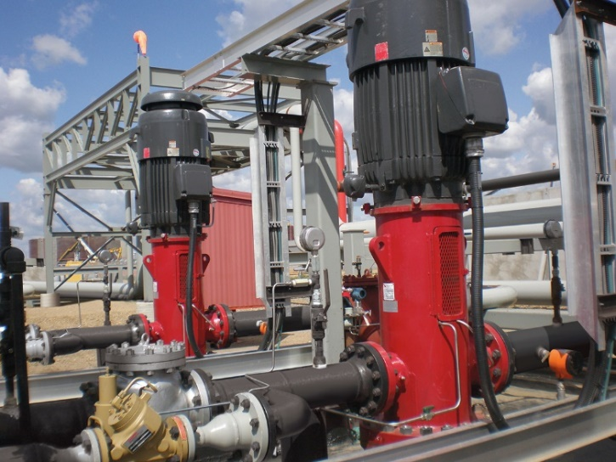
REFINED PETROLEUM (4% - 5%)
Leader in aircraft refueler market
Refinery and pipeline applications
Vertical turbine pumps for barge loading and unloading
American Petroleum Institute certified pumps
Safe bulk handling of volatile fuels
DRIVERS: Petroleum refinery production, storage and distribution; and petroleum transportation expansion

Slide 18
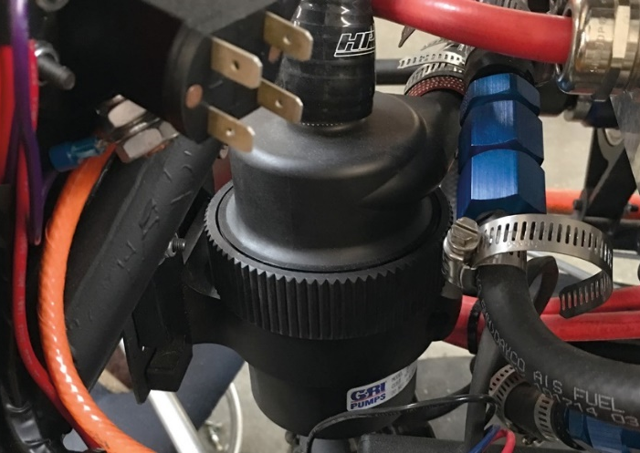
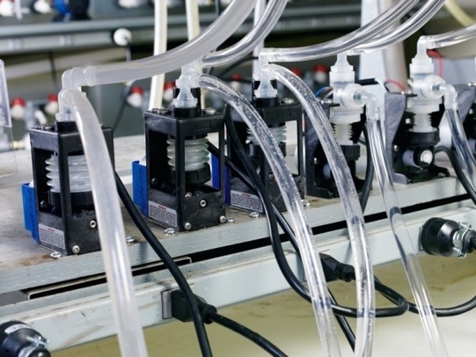
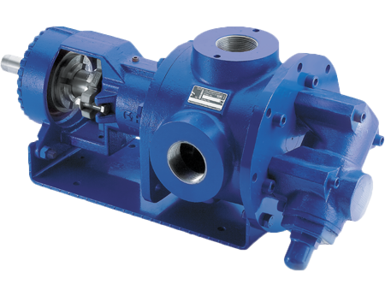
OEM (8% - 10%)
OEM
Pump supplier to a variety of manufacturers
Range of applications from transportation, appliances, food processing, chemical processing and electronics
Military applications
DRIVERS: Growth and new products in numerous commercial, medical and retail sectors, power generation demands

Slide 19
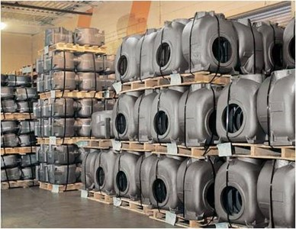
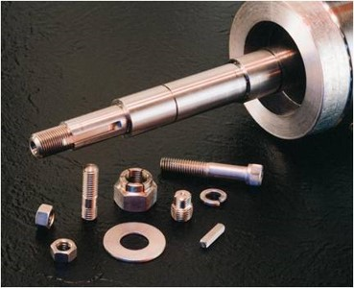
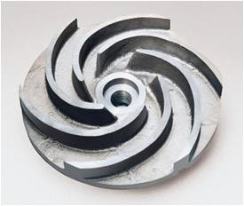
REPAIR PARTS
Most parts ship within 24 hours
Consolidated 12% - 13%
Large range – from 30% for Construction/Industrial to minimal for Fire Suppression
About 17% - 18% adjusted for markets with minimal repairs
How long do pumps last?
Many Variables
The Right Pump for the job!
Abrasive
Wear
Corrosive
Solids
Clean Liquids
Fracking
Construction Rental
Industrial
Municipal
Wastewater
Fire Suppression
Fuel Handling
< 1 Year
5 Years
10 Years
15 Years
20+ Years

Slide 20
DIVISIONS / MARKETS
 | Gorman-Rupp Pumps Group |  |  |  | Patterson Pumps Group |  |  |  | National Pumps Group |  | Custom Pumps Group |  |  | Fill-Rite Company
End Markets
WATER:
Fire Suppression |  |  |  |  |  | l | l
Municipal Water, Wastewater & Flood Control | l | l | l | l |  | l | l |  | l |  |  | l
Construction & Dewatering | l | l | l | l |  |  |  |  |  |  |  | l |  | l
Agriculture & Irrigation Supply | l |  |  | l |  |  |  |  | l |  |  | l |  | l
NON-WATER:
Industrial/Chemicals & HVAC Supply | l | l | l | l |  | l |  |  | l |  |  | l |  | l
Refined Petroleum | l | l |  | l |  |  |  |  | l
Original Equipment Manufacturer (OEM) | l | l |  |  |  | l |  |  | l |  | l | l
International | l | l | l | l |  | l | l |  | l |  | l | l
USA
CANADA
EUROPE
AFRIA

Slide 21
COMPETITION

Slide 22
Notable Pump Competitors
 | GORMAN-RUPP MARKETS
 | Water |  |  |  |  | Non-Water
Company | Fire Suppression | Municipal | Flood Control | Construction | Agriculture | Industrial | Petroleum | OEM
XYLEM (XYL) – ($5.2B; Pumps/Services $3.9B, 74%)
Flygt |  | ü | ü | ü | ü | ü |  | ü
Goulds |  | ü |  | ü | ü | ü | ü
AC Fire Pump | ü |  |  |  |  | ü
Bell & Gossettt |  | ü |  |  |  | ü |  | ü
Godwin Pumps |  | ü | ü | ü
FlowServe (FLS) – ($3.5B; Flow/Pumps $2.5B, 70%)
Worthington | ü | ü | ü | ü | ü | ü | ü | ü
Durco and IDP |  | ü |  | ü | ü | ü | ü | ü
FlowServe | ü | ü | ü | ü | ü | ü | ü | ü
IDEX (IEX) – ($2.8B; Flow/Pumps $1.0B, 36%)
Viking and MicroPump |  |  |  |  |  | ü | ü | ü
Pulsafeeder |  | ü |  |  |  | ü | ü | ü
Roper (ROP) – ($5.8B; Flow/Pumps $0.5B, 9%)
Cornell |  | ü |  |  | ü | ü | ü
Roper |  |  |  |  |  | ü | ü | ü

Slide 23
Notable Pump Competitors
 | GORMAN-RUPP MARKETS
 | Water |  |  |  |  | Non-Water
Company | Fire Suppression | Municipal | Flood Control | Construction | Agriculture | Industrial | Petroleum | OEM
Pentair (PNR) – ($3.8B; 100% Flow/Pumps)
Hydromatic |  | ü |  |  |  | ü |  | ü
Aurora | ü | ü |  |  |  | ü |  | ü
Fairbanks Nijhuis | ü | ü | ü | ü | ü | ü | ü | ü
Franklin Electric (FELE) – ($1.7B; Flow/Pumps $1.0B, 58%)
Pioneer Pump |  | ü |  | ü | ü | ü |  | ü
Dover Corporation (DOV) – ($7.9B; Fluids $3.3B, 42%)
Blackmer |  |  |  |  |  | ü | ü | ü
Wilden |  |  |  |  |  | ü | ü | ü
Ingersoll Rand (IR) – ($5.2B; <15% Flow/Pumps)
ARO |  |  |  |  |  | ü | ü
Seepex |  | ü |  |  |  | ü | ü
Albin Pump
Milton Roy |  | ü |  |  |  | ü | ü
Thomas |  |  |  |  |  | ü

Slide 24
Notable Pump Competitors
 | GORMAN-RUPP MARKETS
 | Water |  |  |  |  | Non-Water
Company | Fire Suppression | Municipal | Flood Control | Construction | Agriculture | Industrial | Petroleum | OEM
SPX Flow (FLOW) – ($1.5B; 100% Flow/Pumps)
Johnson Pump |  |  |  |  |  | ü
Wauckesha Cherry-Burrell |  |  |  |  |  | ü
Power Team |  |  |  |  |  | ü
Gerstenberg Schoder |  |  |  |  |  | ü
Bran+Luebbe |  |  |  |  |  | ü
Host of smaller private companies/divisions
Smith & Loveless |  | ü
BJM / Stancor |  | ü |  | ü | ü | ü
Thompson Pumps |  | ü | ü | ü | ü | ü |  | ü
Zoeller Pumps |  | ü |  | ü |  | ü
Vaughan Pumps |  | ü |  | ü |  | ü
GPI |  |  |  | ü | ü

Slide 25
FINANCIAL SUMMARY

Slide 26
NET SALES & NET INCOME
2013 - 2014
Significant Fracking Activity
PCCP
2013 - $2.7
2014 - $14.4
2015 - $37.7
2016 - $9.9
2020
COVID-19

Slide 27
Strong Ebitda & free cash flow
A)
A) 2018 Free Cash Flow excludes $52.2 million special dividend.

Slide 28
Historical CAPITAL ALLOCATION
Return of capital to shareholders through dividends
Maintenance capital < $10 million per year
Current annualized dividend
rate of $0.68 per share
Special dividend of $2.00 per share in 2018
Capital Expenditures
National Pump Building Expansions
$2.4 Million 2012; $2 Million 2014
Patterson Ireland Expansion 2014-2015
$4.5 Million
Continual Investments in M & E
Acquisitions
GR Africa – 2012
American Turbine Pumps – 2012
Bayou City Pump – 2014
GR Belgium and GR Belgium Rentals – 2015
Morrison Pump – 2016
Fill-Rite - 2022

Slide 29
Commitment to Flexible Financial Policy
Our maintenance capital expenditures are expected to be ~$15mm per year
We have a proud history of returning capital to shareholders through dividends and expect to maintain our dividend practices while achieving our leverage target
We are focused on deleveraging with targeted leverage of less than 3.5x by the end of 2024
Once we delever, acquisitions will remain an important part of our growth strategy, and we will monitor opportunities to complement our existing businesses or expand our core competencies
We expect to maintain ample liquidity for our operations, including ~$20mm of cash on the balance sheet and a $100mm revolving credit facility
✓
✓
✓
✓
✓

Slide 30
GROWTH OF 100 SHARES
Share growth through stock dividends and splits
CAGR of 7.2% since 1968
$113,430 A)
2,323 Shares
A) As of 3/31/22, value of $83,349 at $35.88/share and cash dividends received of $30,081.

Slide 31
HISTORY OF INCREASING DIVIDENDS
289 Consecutive quarters of cash dividends
50 Consecutive years of increased cash dividends
Among Top 50 U.S. Public Companies
Current annualized rate $0.68 per share
1.9%/year of $35.88/share 3/31/22
57% of trailing twelve months earnings/share
Special dividend of $2.00 per share paid 12/10/18 / $52.2 million

Slide 32
Q1 2022 P&L
Q1 2022 Adjusted EPS of $0.29 compared to $0.28 for Q1 2021
Results included an unfavorable LIFO impact of $0.05 and $0.02 per in 2022 and 2021, respectively
Q1 2022 sales of $102.2 million increased 14.8% compared to Q1 2021
Q1 2022 incoming orders of $112.0 million increased 9.6% compared to Q1 2021
Gross margin decreased 90 bps primarily due to increased cost of material from an unfavorable LIFO adjustment of 100 bps, partially offset by improved labor and overhead from increased sales volume
($ in millions) |  | Q1 2022 |  |  |  | Q1 2021
 |  | Dollars |  | % of Net Sales |  | Dollars |  | % of Net Sales
Net Sales |  | $102.2 |  |  |  | $89.0
Gross Profit |  | 25.5 |  | 25.0% |  | 23.0 |  | 25.9%
SG&A |  | 16.0 |  | 15.7% |  | 14.1 |  | 15.8%
Operating Income |  | 9.5 |  | 9.3% |  | 9.0 |  | 10.1%
Adjusted Net Income |  | 7.5 |  | 7.4% |  | 7.4 |  | 8.3%
Adjusted EPS |  | $0.29 |  |  |  | $0.28

Slide 33
Year ended DECEMBER 31, 2021 P&L
YTD 2021 Adjusted EPS of $1.21 compared to $1.11 for 2020
Results included unfavorable LIFO impacts of $0.20 and $0.03 in 2021 and 2020, respectively
Results included non-cash pension settlement charges of $0.07 and $0.14 per share in 2021 and 2020, respectively
YTD 2021 sales increased 8.4% or $29.3 million
Incoming orders YTD increased 26.9% compared to the same period last year
Backlog improved to $186.0 million at December 31, 2021 compared to $113.1 million at December 31, 2020
Gross margin decreased 40 bps primarily due to increased cost of material from an unfavorable LIFO adjustment of 180 bps, partially offset by improved labor and overhead from increased sales volume
($ in millions) |  | YTD 2021 |  |  |  | YTD 2020
 |  | Dollars |  | % of Net Sales |  | Dollars |  | % of Net Sales
Net Sales |  | $378.3 |  |  |  | $349.0
Gross Profit |  | 95.9 |  | 25.3% |  | 89.6 |  | 25.7%
SG&A |  | 56.5 |  | 14.9% |  | 53.8 |  | 15.4%
Operating Income |  | 39.4 |  | 10.4% |  | 35.8 |  | 10.2%
Adjusted Net Income ⁽¹⁾ |  | 31.7 |  | 8.4% |  | 28.9 |  | 8.3%
Adjusted EPS ⁽¹⁾ |  | $1.21 |  |  |  | $1.11
(1) 2021 excludes non-cash pension settlement charges of $1.8 million, net of income taxes ($0.07 per share). 2020 excludes non-cash pension settlement charges of $3.7 million, net of income taxes ($0.14 per share). See appendix for non-GAAP reconciliations.

Slide 34
BALANCE SHEET
Accounts receivable build on higher sales
Inventory and current liabilities up with higher material cost and increased backlog
($ in millions) | March 31, 2022 |  |  | December 31, 2021
ASSETS
Cash and cash equivalents |  | $122.7 |  |  | $125.2
Accounts receivable, net |  | 67.7 |  |  | 58.5
Inventories, net |  | 90.0 |  |  | 85.6
Prepaid and other |  | 8.3 |  |  | 7.9
Total current assets |  | $288.7 |  |  | $277.2
Property, plant and equipment, net |  | 104.2 |  |  | 104.3
Other assets |  | 38.4 |  |  | 39.3
Total assets |  | $431.3 |  |  | $420.8
 | March 31, 2022 |  |  | December 31, 2021
LIABILITIES & SHAREHOLDERS’ EQUITY
Total current liabilities |  | $59.5 |  |  |  | $52.4
Pension and postretirement benefits |  | 36.9 |  |  |  | 36.7
Other long-term liabilities |  | 1.7 |  |  |  | 1.7
Total liabilities |  | $98.1 |  |  |  | $90.8
Total shareholders’ equity |  | 333.2 |  |  |  | 330.0
Total liabilities & shareholders’ equity |  | $431.3 |  |  |  | $420.8

Slide 35
PILLARS FOR GROWTH

Slide 36
PILLARS FOR GROWTH
Organic
International
Acquisitions

Slide 37
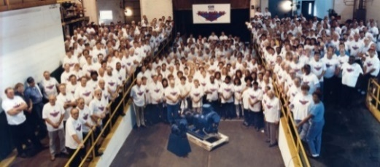
Well positioned for ORGANIC GROWTH
Broad network of global distributors
Over two million square feet of design,
manufacturing and distribution space worldwide
ISO Certified 9001, 14001 – GR Pumps USA, Patterson, National Pump and GR Industries
New product development
State of the art testing facilities
Excellent employee relations, all facilities union free
1,400 employees worldwide with experience of over 10 years on average
Gorman-Rupp Continuous Improvement program at all
locations
Market diversity helps minimize impact of downturns

Slide 38
ORGANIC GROWTH drivers
Aging U.S. infrastructure –
Potential infrastructure bill including investment in water, wastewater and flood control
Bill needed to address estimated $2.6 trillion gap⁽¹⁾ in required infrastructure spending over the next 10 years
Oil and gas markets recovery
Well positioned to capitalize on agriculture market
High value of retained customers – service, repairs and replacements
Increasing regulatory requirements related to environmental, quality and energy efficiency
Investment in R&D – history of innovation
Emphasis on customer training and education
U.S. Infrastructure Report Card⁽¹⁾
Drinking Water | C-
Wastewater | D+
Storm Water | D
(1) American Society of Civil Engineers 2021 Infrastructure Report Card

Slide 39
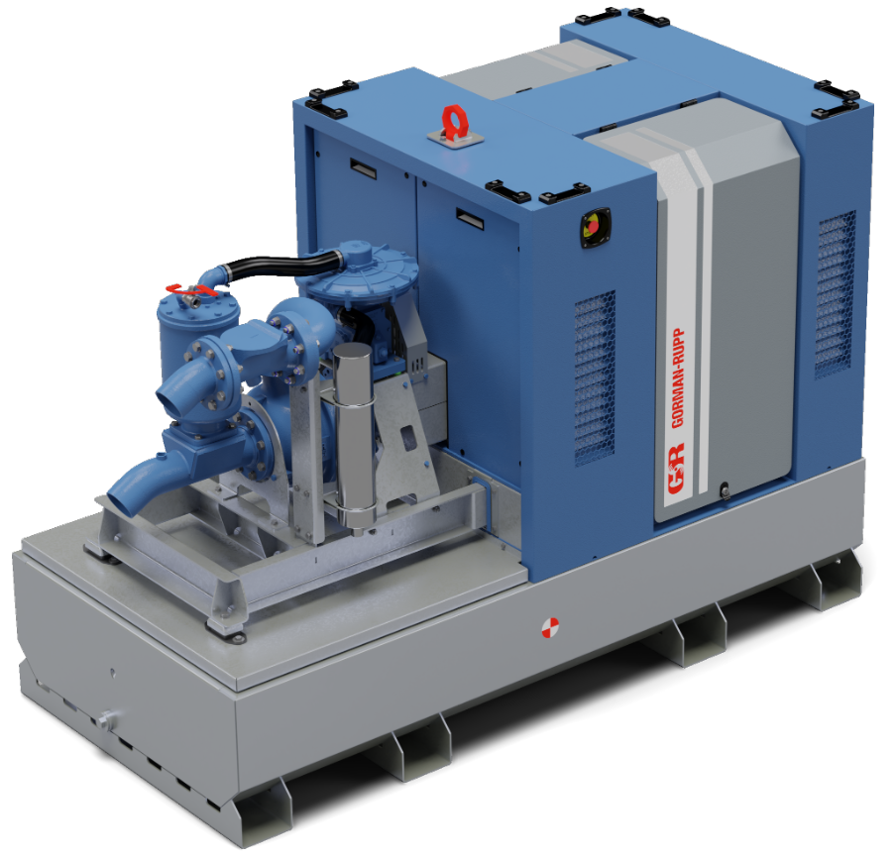
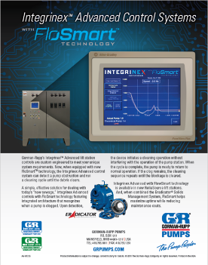
PRODUCT INNOVATION
Majority of products continue to be made in the USA
Strong team of experienced engineers providing project-specific engineering expertise and new product development
Continued advancements in challenging applications like clogged sewage systems or abrasive materials
Advanced monitoring and control with IoT will continue to develop
Advancements in pump efficiency, reduced emissions and alternative power sources
NSF61 Drinking Water Certification
Registered full pump including the “can”
European Stage 5 Hydrogenated
Vegetable Oil Engine
Driven Units
Technology reduces CO2 emissions
by 89% vs. fossil fuels
Flow Smart and Eradicator
Clog sensing and clearing control technology for lift stations
Integrity Series Smart Pumps
Brushless DC mag drive centrifugal
pumps with IoT

Slide 40
Process INNOVATION
Focus on customer facing technology with ability to research, configure and order
Easy on-line access to customer specific pump specifications, user manuals and parts ordering
Integration of 3D printing capabilities into new product develop and factory productivity improvements
State of the art test labs allowing difficult field conditions to be duplicated in house
Revolution (NPC)
Pricing software has allowed rapid quotations/ordering fostering improved margins
Serial Number Specific QR Codes
Provides customer with easy access to individual pump specifications, user manuals and drawings
Hydraulic Institute Certified Test Lab
Patterson test lab certified to HI Pump test lab approval program 40.7 standard

Slide 41
CUSTOMER TRAINING AND EDUCATION
Customer visits and plant tours are part of sales process
Increased use of technology to deliver virtual training during
COVID-19
Long history of product education and training of both distribution and customers
In-house training and testing facilities that can simulate field conditions
Mobile training equipment supports customer site training

Slide 42
INTERNATIONAL DISTRIBUTION CAPABILITY
International sales represent approximately 31% of total company sales annually

Slide 43
GORMAN-RUPP INTERNATIONAL LOCATIONS
Well positioned international facilities
Capacity for growth
DIVISION | LOCATION
Gorman-Rupp Canada | Ontario, Canada
Gorman-Rupp Africa | Johannesburg, South Africa
Gorman-Rupp Europe | Waardenburg, The Netherlands
Gorman-Rupp Belgium | Namur, Belgium
Patterson Pump Ireland | County Westmeath, Ireland
Gorman-Rupp Canada
Gorman-Rupp Africa
Gorman-Rupp Europe
Gorman-Rupp Belgium
Patterson Pump Ireland

Slide 44
DRIVERS OF INTERNATIONAL GROWTH
Population growth and urbanization increasing infrastructure needs
Industrialization in developing countries
Accelerating need for water recycling and water & wastewater treatment systems
Increasing industrial and agriculture needs
Sanitation needs – lack of access to proper sanitation worldwide
Drinking water – millions of people worldwide lack access to safe drinking water
Water scarcity – by 2025, as much as two-thirds of the world’s population could be living in areas where water is in short supply, according to the United Nations

Slide 45
History of growth through ACQUISITIONS
Gorman-Rupp has successfully grown through acquisitions
Financial strength to continue acquisitions
Approach to acquisitions remains disciplined and selective
Acquisitions since 2010:
Year | Company | Locations | Key Markets
2010 | National Pump Company | AZ, CA, TX, MS, FL | Agriculture, Municipal, Petroleum, Industrial
2012 | American Turbine | TX, CA | Agriculture
2012 | Pumptron | Johannesburg, South Africa | Municipal, Industrial
2014 | Bayou City Pump | TX | Industrial, Petroleum
2015 | Hydro & Hydro+ | Namur, Belgium | Municipal, Industrial, Construction
2016 | Morrison | FL | Municipal, Flood Control
2022 | Fill-Rite | Fort Wayne, IN and Lenexa, KS | Agriculture, Construction

Slide 46
Fill-rite ALIGNS with Gorman-Rupp’s Disciplined M&A Criteria
Criteria | Preferences
Products | Pumps or pumping related equipment and systems that complement existing product lines
Markets | Chemical / Fuels Municipal Alternative Energy Marine Food / BEV / Pharma | HVAC OEM Industrial Dredging
Culture | Customer-Focused Employee Focused Quality-Focused
Regions | U.S., Europe, Asia
Competitive Landscape | Leading Brands/Positions in Niche Markets
Condition of Business | Not a turnaround situation
Structure | Bolt-on with compatible management that is retained post acquisition
Financial Performance | Attractive profitability, growing, accretive near term, meets IRR requirements
Size | $25MM to $150MM in Revenue
Fill-Rite acquisition
✓
Premier fuel and chemical transfer pumps across agriculture, construction, mining, marine, fleets, and municipalities
High-quality operations with outstanding culture and demand for excellence in business and service
#1 brand in the 0-35 GPM fuel transfer pump industry
Strong and experienced management team committed to continuing in current roles
Steady revenue growth complemented by a strong margin and cash flow profile that is expected to contribute double digit percentage accretion in 2023
Potential for commercial synergies
✓
✓
✓
✓
✓

Slide 47
FILL-RITE ExpandS Portfolio of Mission-Critical Pumps and Systems
Key highlights
Complements and expands Gorman-Rupp’s portfolio of products in mission-critical applications and adjacent end markets
Agriculture and construction end markets set to benefit from rising demand in equipment spend, harvesting and infrastructure activity
Enhances brand recognition with the #1 brand in fuel transfer pump industry
Strong collective of distribution partners with added exposure and opportunity in retail and e-Commerce channels, and international expansion
Adds capabilities in lower flow rate, consumer-facing pumps
Pipeline of new product development
✓
✓
✓
✓
✓
✓

Slide 48
Highly Diversified and Enhanced Financial Portfolio
+
Pro Forma
($mm)
2021A | Sales | $378 | $132 | $511
 | Gross Margin | 25.3% | 43.2% | 30.0%
 | Adj. EBITDA margin | 15.4%¹ | 24.9% | 17.9%
(Assumes no synergies)
End market breakdown²
Geography breakdown²
1 Includes $6.7mm LIFO adjustment; 2 Based on FY2021A; 3 Includes municipality, logging, marine, mining, aviation and other; 4 Includes Sotera revenues; 5 Includes all Fill-Rite revenues, except agriculture, construction, and Sotera; 6 Includes Gorman-Rupp’s sales in Middle East, Asia/Oceania, and Africa and Fill-Rite’s sales outside of USA, Canada, and Mexico and South & Central America

Slide 49
SUSTAINABILITY
Gorman-Rupp companies are committed to advancing the
health, safety and wellness of our employees, customers
and communities by:
Making a positive impact on our communities through philanthropy and social engagement;
Reducing our impact on the environment through resource conservation and waste prevention;
Treating employees fairly, with dignity, and without discrimination – and maintaining similar expectations of our supply chain partners; and
Providing training and development programs that attract diverse, motivated employees and help them reach their full potential.

Slide 50
INVESTMENT HIGHLIGHTS
Over 85 years of innovation and quality pump leadership
Consistent management team with proven results
Product and market diversification
Well positioned for long-term sustainable growth
History of returning capital to shareholders
Fill-Rite is expected to be accretive to current operating metrics including organic growth, gross margins, and EBITDA margins

Slide 51
BIOS
Jeffrey S. Gorman, Executive Chairman
Jeff has been Chairman of the Board since 2019. He previously served as CEO from 1998 to 2021 and President from 1998 to 2020. He was elected to the Board of Directors for The Gorman-Rupp Company in 1989. In 1978, he started working on the factory floor and has progressed through many positions including Sales, Corporate Secretary, Assistant and General Manager and Senior Vice President of the corporation.
Mr. Gorman completed his Bachelor of Science degree in business administration in 1974 with majors in business management and economics. Jeff is active in his community and was the Chairman of the Ohio Chamber of Commerce . In addition, he sits on the Board of Advisors for Ashland University’s John M. Ashbrook Center for Public Affairs, the Board of Directors of Mechanics Bank and the Richland Community Development Group. He also serves as Chairman of the City of Mansfield Airport Commission and holds an Airline Transport Pilot rating.
Scott A. King, President and Chief Executive Officer
Scott was promoted to Chief Executive Officer in January 2022 in addition to his role as President. He served as President and Chief Operating Officer from January 2021 to December 2021. Prior to that he was Vice President and Chief Operating Officer since April 2019 and was previously Vice President of Operations. He was elected to the Board of Directors for The Gorman-Rupp Company in 2021. In 2004, he joined the Gorman-Rupp Pumps USA division as Manufacturing Manager and progressed through multiple positions including Director of Manufacturing, and General Manager.
Mr. King completed his Bachelor of Science degree in Mechanical Engineering from the University of Minnesota in 1996 and Masters in Business Administration from the University of Michigan in 2002. In addition, Mr. King is active in his community. He is the past President of the Rotary Club of Mansfield, OH and a Board member of the Club’s Foundation; past President of the Regional Manufacturing Coalition; and a member of the Board of Directors for the Hydraulic Institute.
James C. Kerr, Executive Vice President and Chief Financial Officer
Jim joined the company in July 2016. Prior to joining The Gorman-Rupp Company, Mr. Kerr served, for nine years, as the Chief Financial Officer for a retail chain with over $2 billion in sales. Mr. Kerr has served in various financial leadership positions with several multi-billion dollar companies, primarily in the consumer products sector. Prior to that, Jim had experience in public accounting as an Audit Manager with Arthur Andersen & Co. Mr. Kerr’s experience includes working with both public and privately held companies.
Mr. Kerr has experience in strategic planning, profit improvement, mergers & acquisitions, financing, risk management and information systems planning and implementation. Jim holds a Bachelors Degree in Accounting from Baldwin Wallace University.

Slide 52
APPENDIX
The Gorman-Rupp Company Non-GAAP Measures
Management utilizes these adjusted financial data and measures to assess comparative operations against those of prior periods without the distortion of non-comparable factors. The Gorman-Rupp Company believes that these non-GAAP financial data and measures will be useful to investors in assessing the continuing strength of the Company’s underlying operations from period to period. Following is a reconciliation of non-GAAP measures. The adjusted amounts exclude non-cash pension settlement charges in 2021.

Slide 53
Non-gaap reconciliation
 | Three Months Ended March 31, 2022 |  |  |  | Three Months Ended March 31, 2021
 | As Reported – GAAP Basis | Adjustments* | Adjusted |  | As Reported – GAAP Basis | Adjustments* | Adjusted
Net Sales | $102.2 | - | $102.2 |  | $89.0 | - | $89.0
Gross Profit | 25.5 | - | 25.5 |  | 23.0 | - | 23.0
SG&A | 16.0 | - | 16.0 |  | 14.1 | - | 14.1
Operating Income | 9.5 | - | 9.5 |  | 9.0 | - | 9.0
Net Income | 7.5 | - | 7.5 |  | 7.4 | - | 7.4
EPS | $0.29 | - | $0.29 |  | $0.28 | - | $0.28
 | Year Ended December 31, 2021 |  |  |  | Year Ended December 31, 2020
 | As Reported – GAAP Basis | Adjustments* | Adjusted |  | As Reported – GAAP Basis | Adjustments* | Adjusted
Net Sales | $378.3 | - | $378.3 |  | $349.0 | - | $349.0
Gross Profit | 95.9 | - | 95.9 |  | 89.6 | - | 89.6
SG&A | 56.5 | - | 56.5 |  | 53.8 | - | 53.8
Operating Income | 39.4 | - | 39.4 |  | 35.8 | - | 35.8
Net Income | 29.9 | 1.8 | 31.7 |  | 25.2 | 3.7 | 28.9
EPS | $1.14 | $0.07 | $1.21 |  | $0.97 | $0.14 | $1.11
* Adjustments represents non-cash pension settlement charges.

Slide 54
Non-gaap reconciliation
 | Three Months Ended March 31, |  |  |  | Year Ended December 31,
 | 2022 |  | 2021 |  | 2021 |  | 2020
Adjusted earnings before interest, taxes, depreciation and amortization:
Reported net income – GAAP basis | $7.5 |  | $7.4 |  | $29.9 |  | $25.2
Plus income taxes | 2.0 |  | 1.9 |  | 7.4 |  | 6.0
Plus depreciation and amortization | 3.0 |  | 3.0 |  | 11.9 |  | 12.7
Non-GAAP earnings before interest, taxes, depreciation and amortization | 12.5 |  | 12.3 |  | 49.2 |  | 43.9
Plus pension settlement charge | - |  | - |  | 2.3 |  | 4.6
Non-GAAP adjusted earnings before interest, taxes, depreciation and amortization | $12.5 |  | $12.3 |  | $51.5 |  | $48.5
The following table reconciles adjusted earnings before interest, income taxes and depreciation and amortization as reconciled above to free cash flow:
 | Three Months Ended March 31, |  |  |  | Year Ended December 31,
 | 2022 |  | 2021 |  | 2021 |  | 2020
Non-GAAP adjusted earnings before interest, taxes, depreciation and amortization: | $12.5 |  | $12.3 |  | $51.5 |  | $48.5
Less capital expenditures | (3.5) |  | (0.9) |  | (9.8) |  | (8.0)
Less regular cash dividends | (4.4) |  | (4.0) |  | (16.6) |  | (15.4)
Non-GAAP free cash flow | $4.6 |  | $7.4 |  | $25.1 |  | $25.1

